Slide 1
Provenance research under the spotlight
Digital Edition of the Annual Reports of the Museum 1887-1915 and 1928-1938

Slide 2
Talk outline
The annual Reports of the museum in the Chronicles
CIDOC CRM as Data model
Project status
Product
Visualized semantic graphs
Website

Slide 3
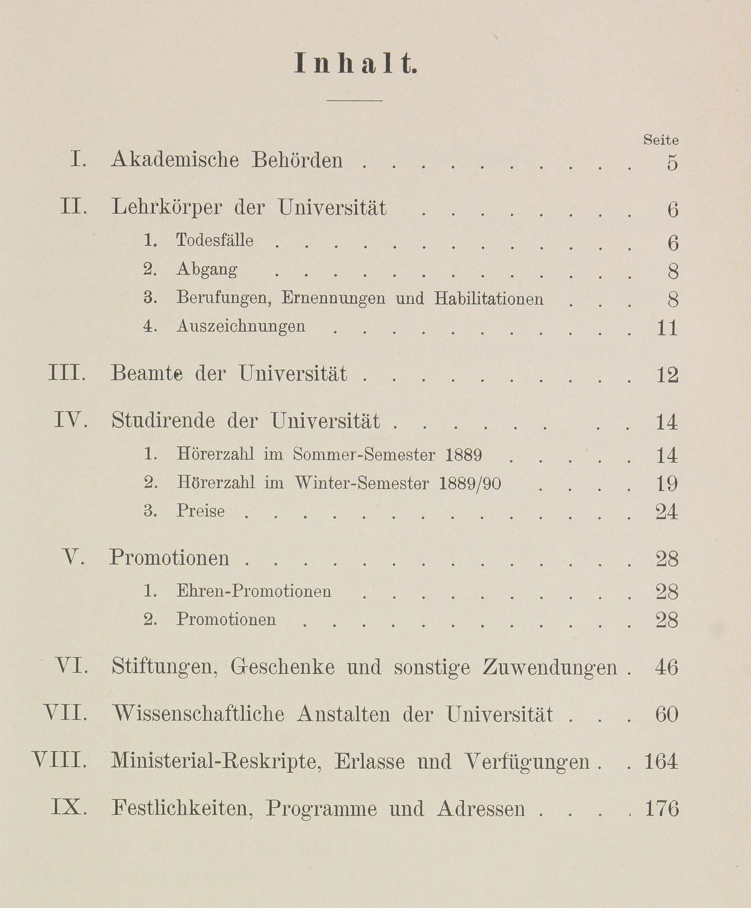
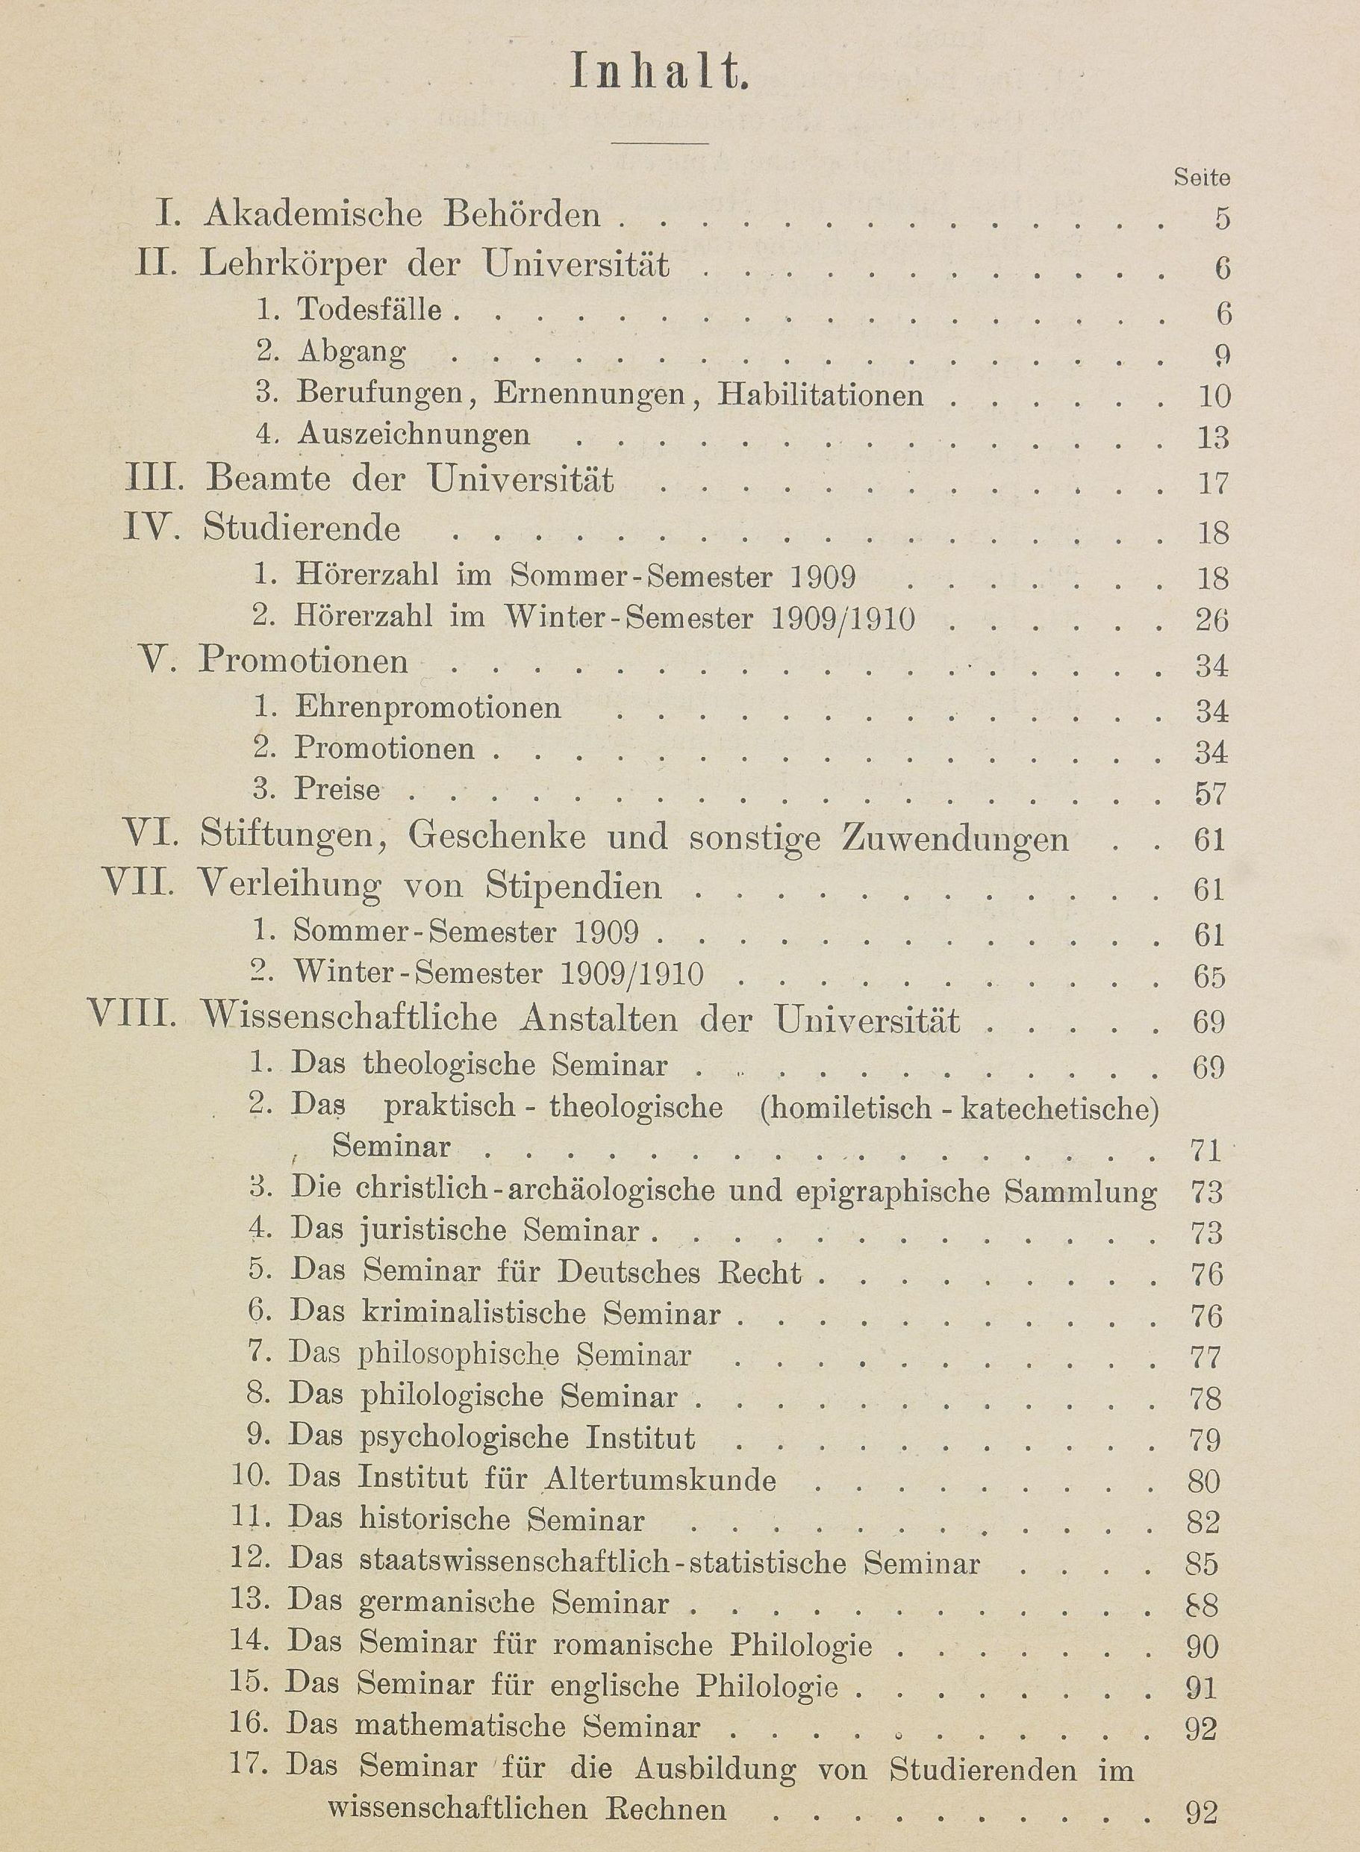
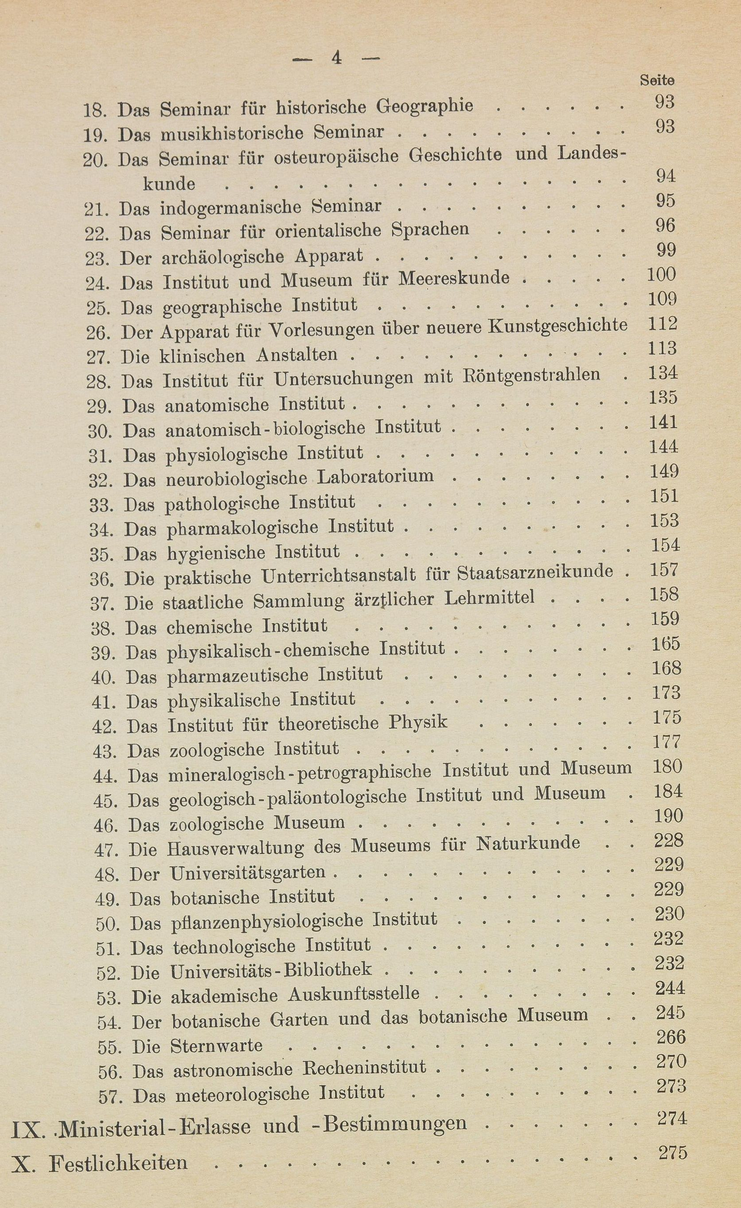
Annual Reports 1887–1915 and 1928–1938
1889/1890
1909
Digitized by HU Bibliothek: https://www.digi-hub.de/viewer/toc/BV046933380/1/-/

Slide 4
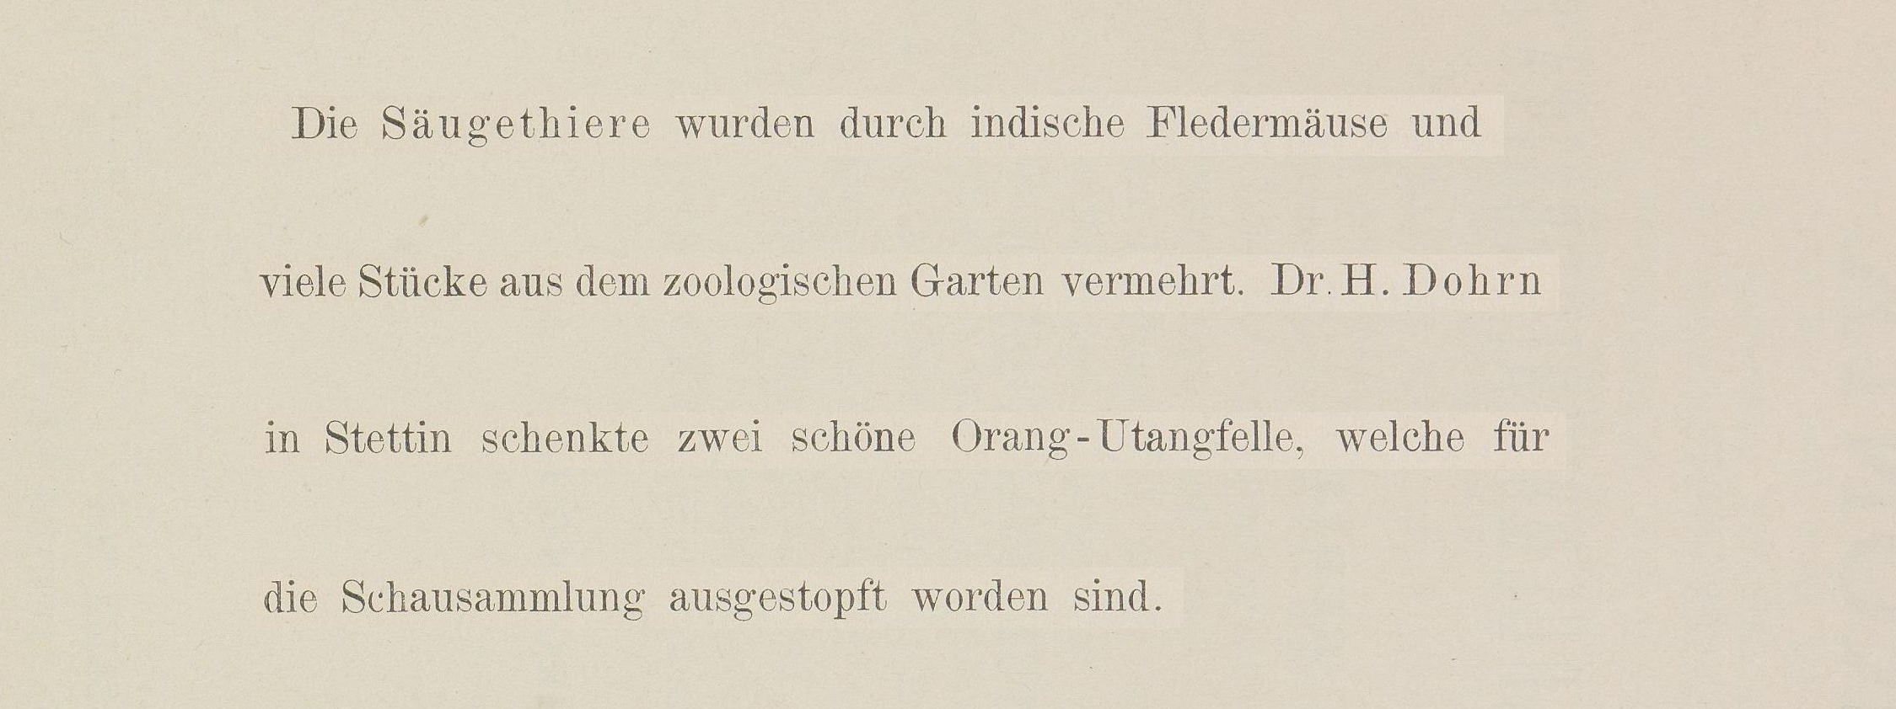
Modeling semantic Information I
Chronik der Friedrich-Wilhelms-Universität zu Berlin, Vol. 4 (1891), p. 125

Slide 5
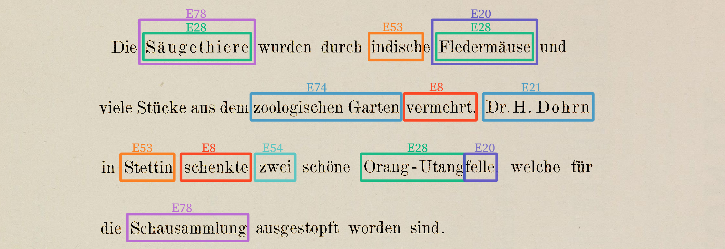
Modeling semantic Information II
Chronik der Friedrich-Wilhelms-Universität zu Berlin, Vol. 4 (1891), p. 125

Slide 6
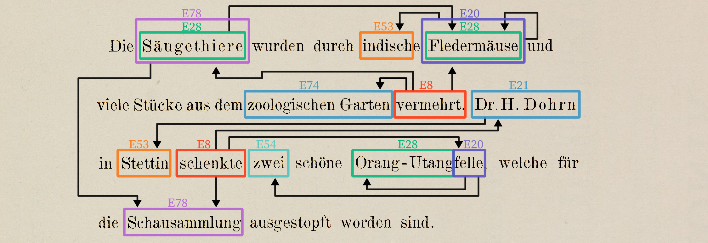
Modeling semantic Information III
Chronik der Friedrich-Wilhelms-Universität zu Berlin, Vol. 4 (1891), p. 125

Slide 7
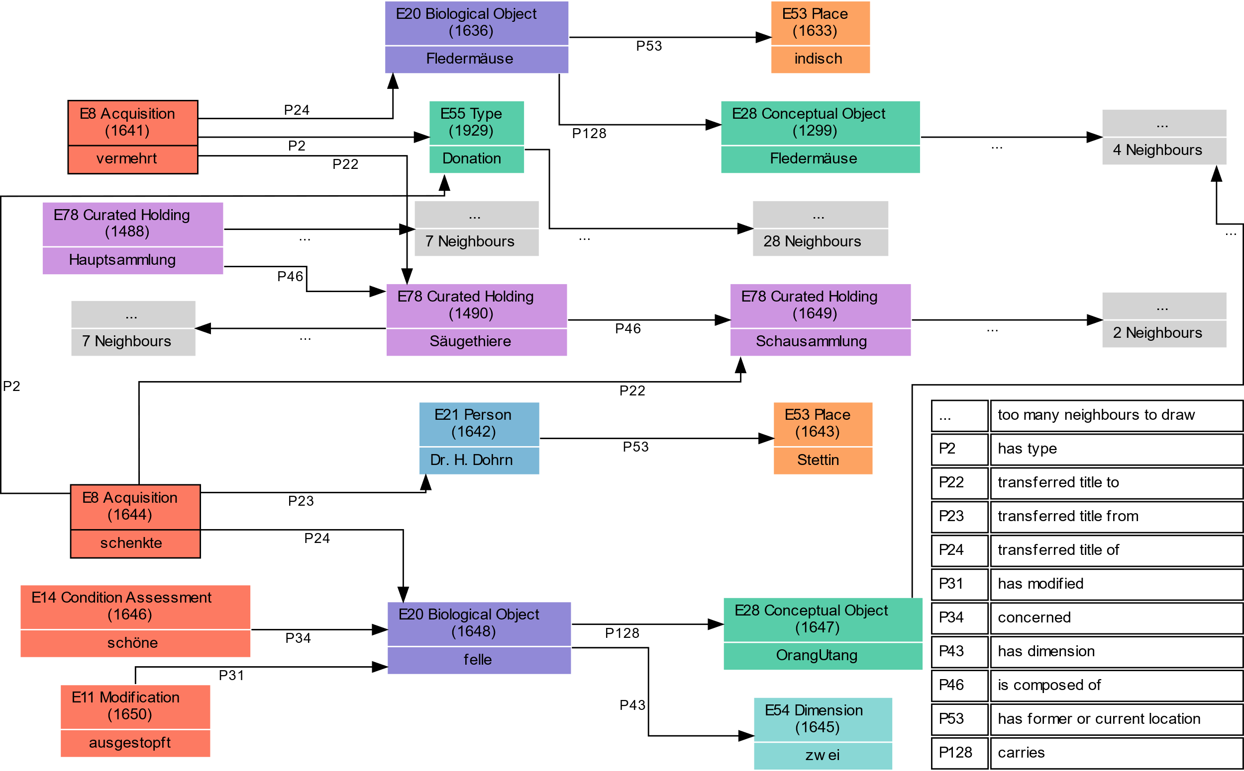
Modeling semantic Information IV

Slide 8
Naturkundemuseum in the Chronicles
964 Pages
60
Museum für Naturkunde – (Haus-)Verwaltung
Mineralogisch-petrographisches Institut/Museum/Sammlung
50
Geologisch-paläontologisches Institut/Museum/Sammlung
Zoologisches Institut/Museum/Sammlung
40
Number of Pages
30
20
10
0
1890
1900
1910
1920
1930
1940
Year

Slide 9
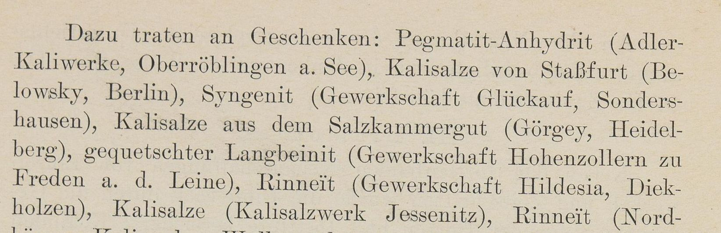
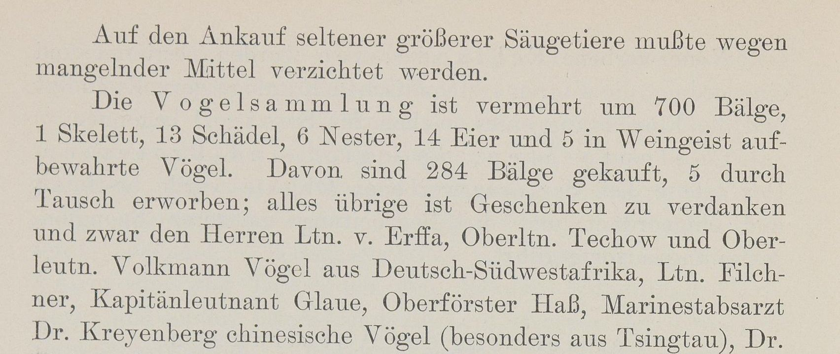
Inflow and outflow of objects in the collections
Chronik der Friedrich-Wilhelms-Universität zu Berlin, Vol. 23 (1909), S. 184
Topics addressed in the annual reports
Chronik der Friedrich-Wilhelms-Universität zu Berlin, Vol. 18 (1904), S. 186

Slide 10
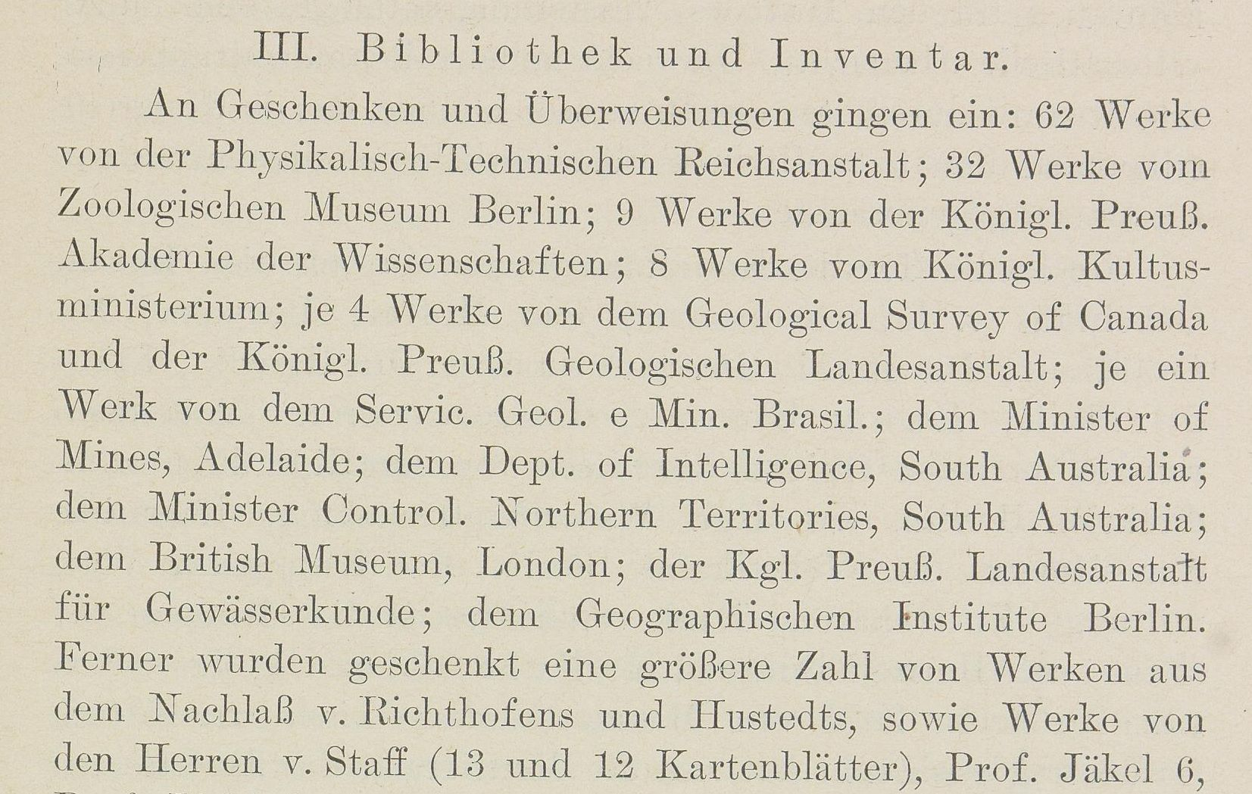
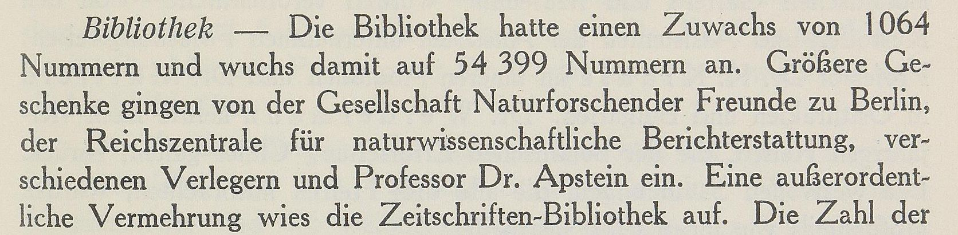
Acquisitions of publications in the library
Topics addressed in the annual reports
Chronik der Friedrich-Wilhelms-Universität zu Berlin, Vol. 23 (1909), S. 191
Chronik der Friedrich-Wilhelms-Universität zu Berlin, 1927/1928, S. 107

Slide 11
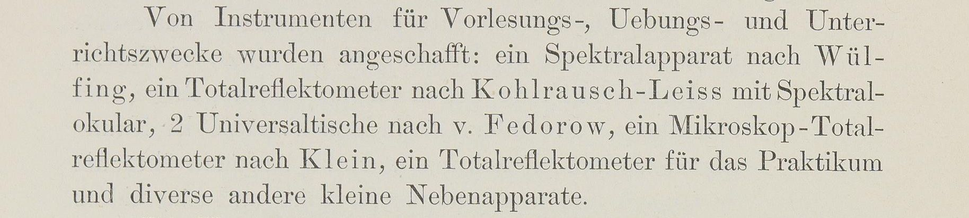
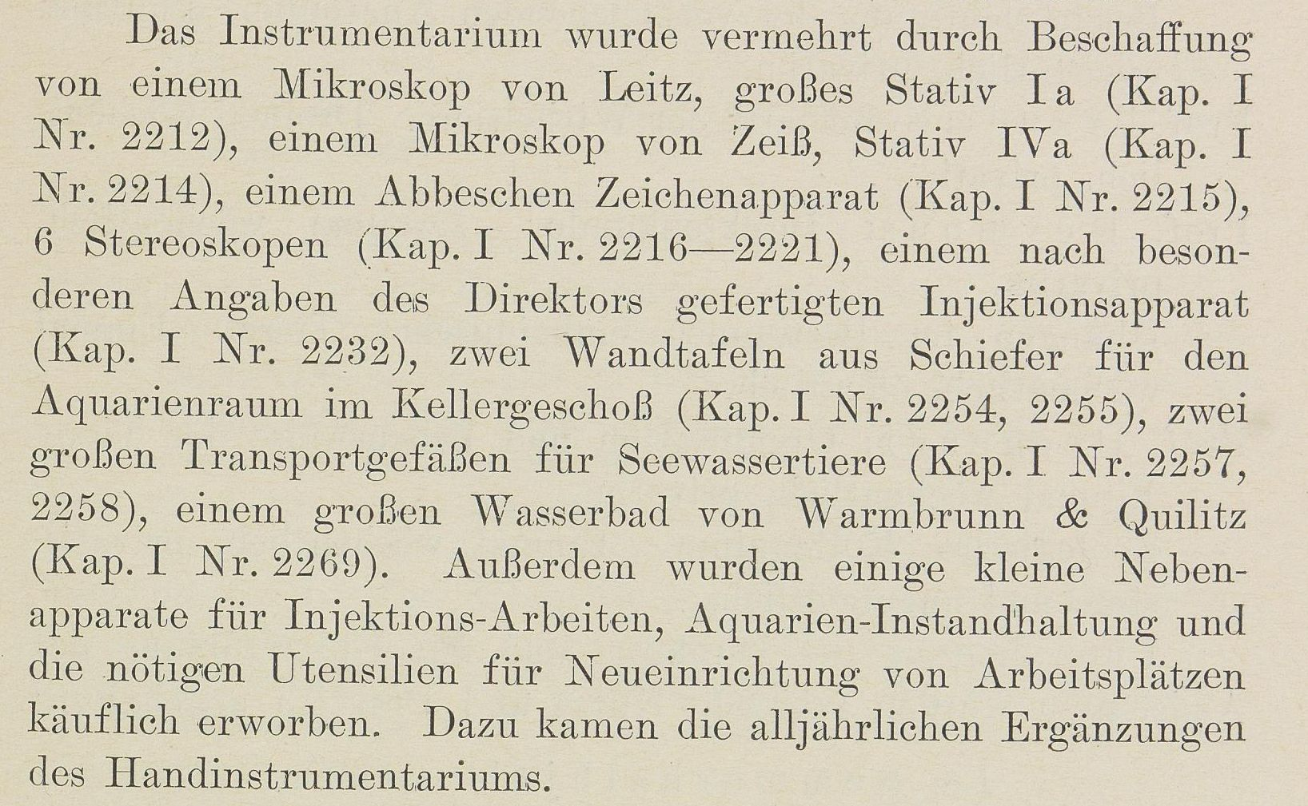
Acquisitions of instruments
Chronik der Friedrich-Wilhelms-Universität zu Berlin, Vol. 13 (1899), S. 146
Topics addressed in the annual reports
Chronik der Friedrich-Wilhelms-Universität zu Berlin, Vol. 23 (1909), S. 181

Slide 12
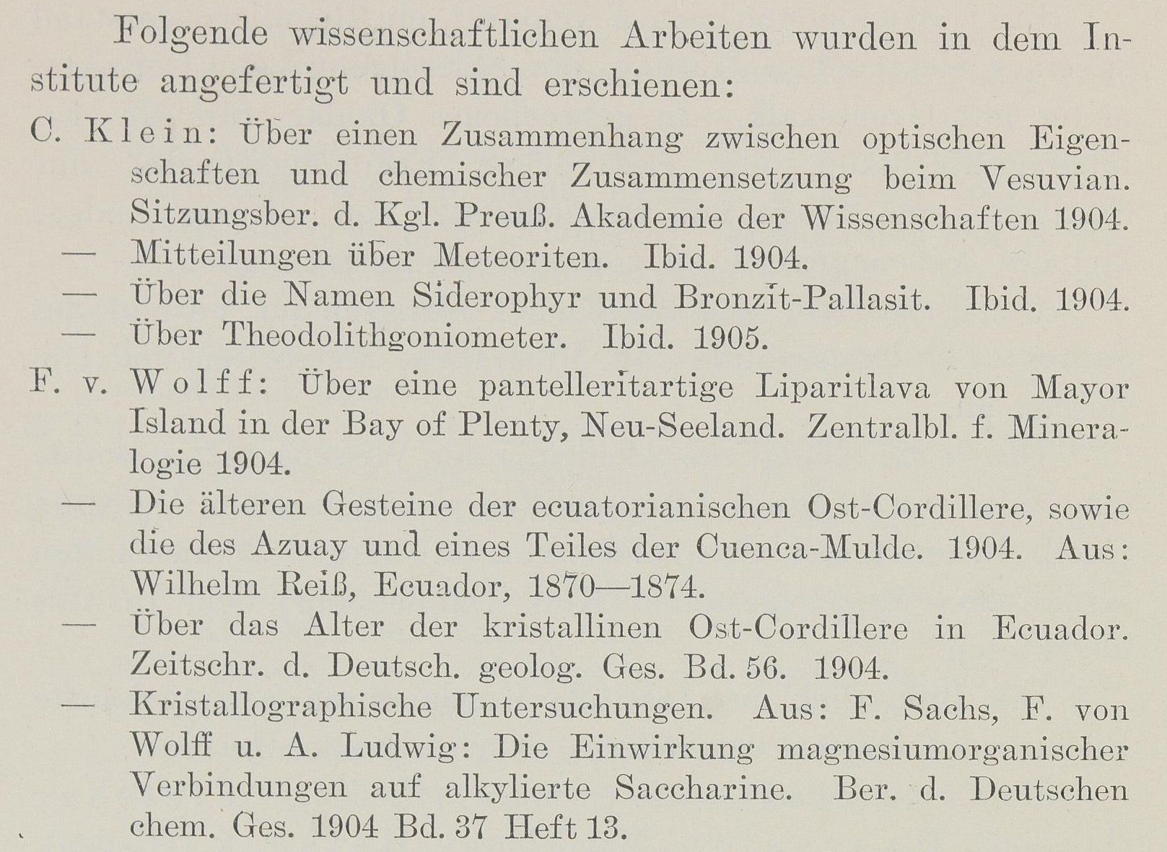
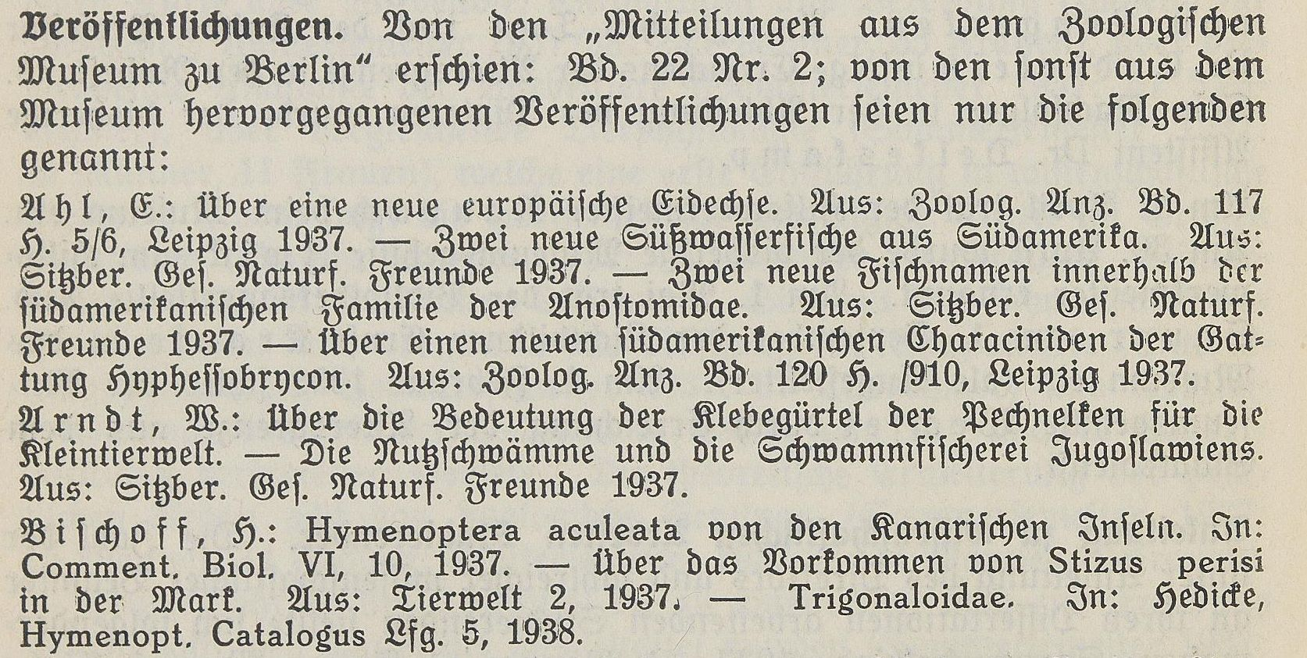
Publications
Chronik der Friedrich-Wilhelms-Universität zu Berlin, Vol. 18 (1904), S. 170
Topics addressed in the annual reports
Chronik der Friedrich-Wilhelms-Universität zu Berlin, 1937/1938, S. 162

Slide 13
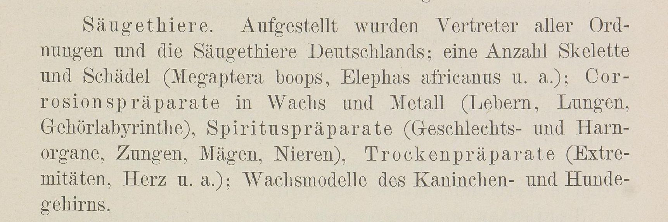
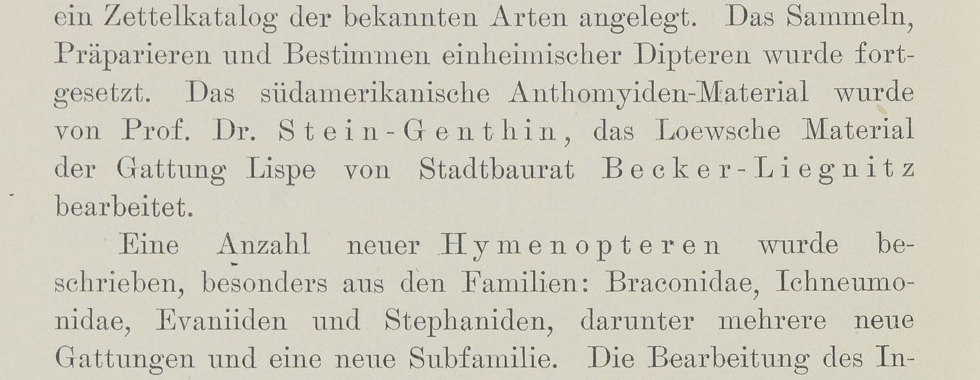
Development of the museum infrastructure, spatial arrangements, scientific evaluation and curation
Chronik der Friedrich-Wilhelms-Universität zu Berlin, Vol. 18 (1889), S. 141
Topics addressed in the annual reports
Chronik der Friedrich-Wilhelms-Universität zu Berlin, Vol. 18 (1904), S. 182

Slide 14
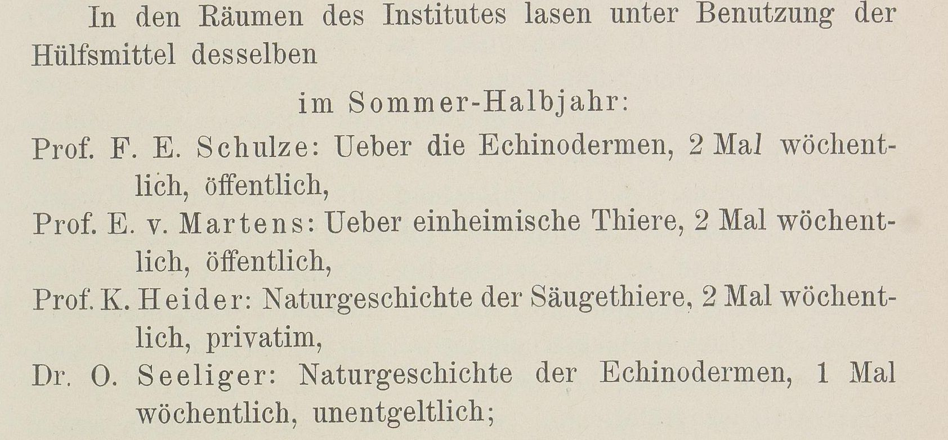
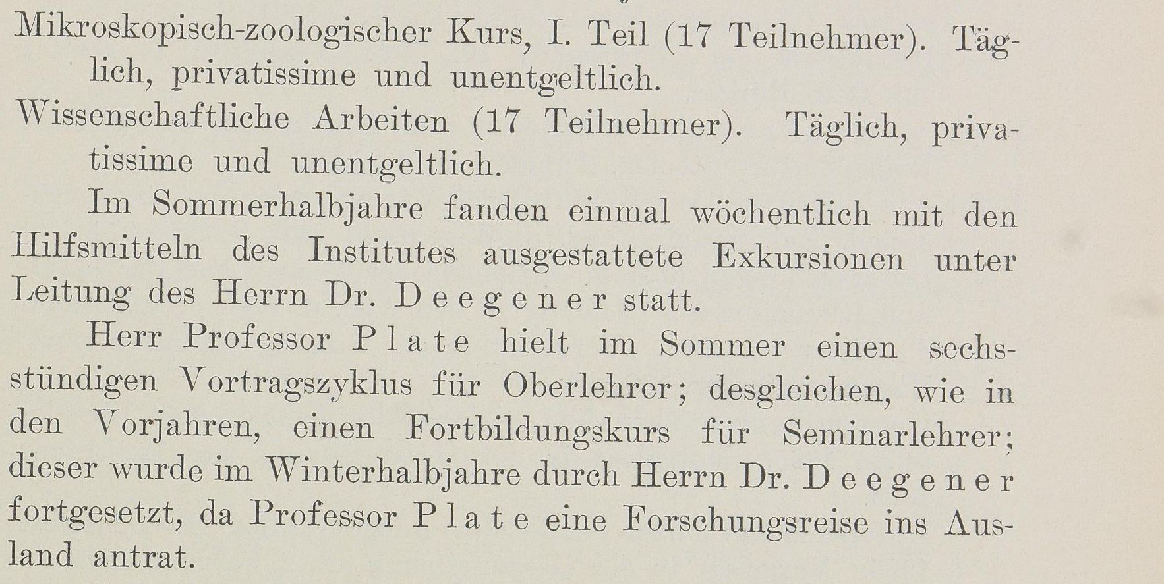
Lectures
Chronik der Friedrich-Wilhelms-Universität zu Berlin, Vol. 8 (1894), S. 113
Topics addressed in the annual reports
Chronik der Friedrich-Wilhelms-Universität zu Berlin, Vol. 18 (1904), S. 159

Slide 15
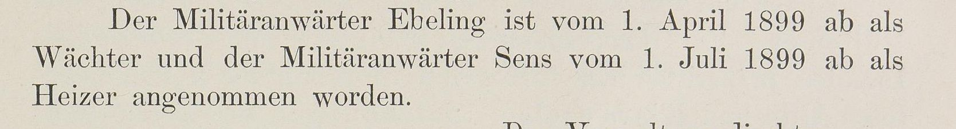
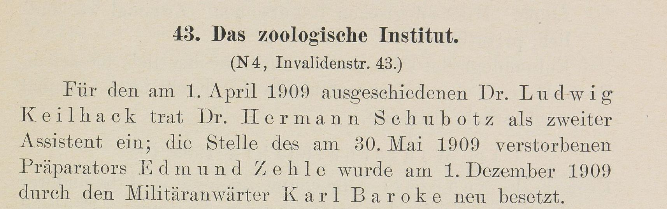
Organisational structure, Personnel changes
Chronik der Friedrich-Wilhelms-Universität zu Berlin, Vol. 13 (1899), S. 121
Topics addressed in the annual reports
Chronik der Friedrich-Wilhelms-Universität zu Berlin, Vol. 23 (1909), S. 181

Slide 16
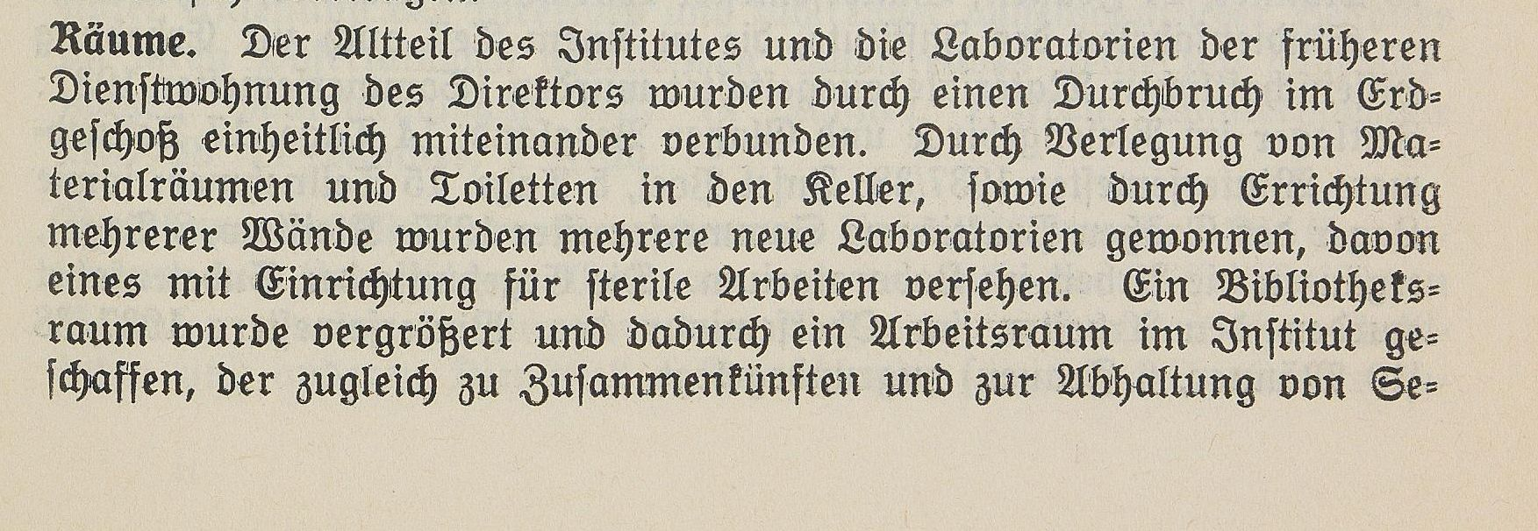
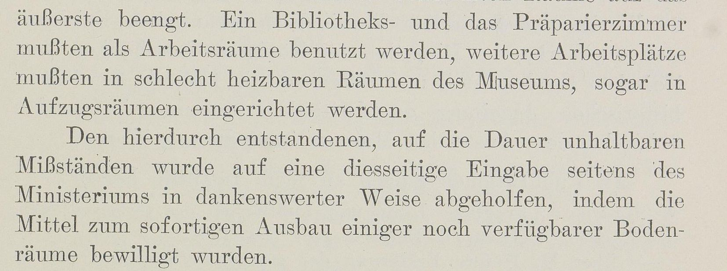
Use of space
Chronik der Friedrich-Wilhelms-Universität zu Berlin, 1937/1938, S. 159
Topics addressed in the annual reports
Chronik der Friedrich-Wilhelms-Universität zu Berlin, Vol. 18 (1904), S. 173

Slide 17
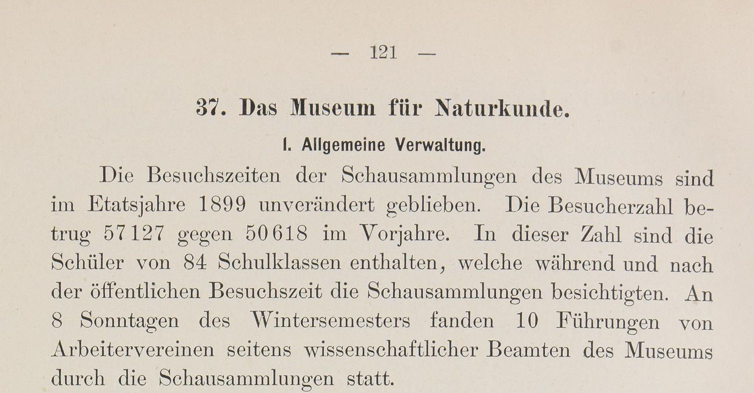
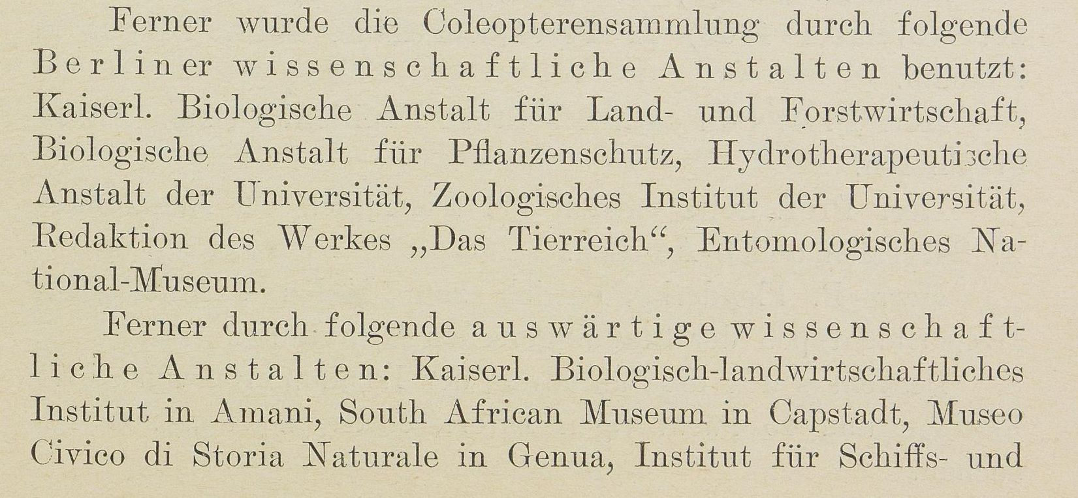
Public Sphere
audience
Chronik der Friedrich-Wilhelms-Universität zu Berlin, Vol. 13 (1899), S. 121
Topics addressed in the annual reports
scientific community
Chronik der Friedrich-Wilhelms-Universität zu Berlin, Vol. 23 (1909), S. 225

Slide 18

Words per topic
Für eine Einschätzung, welches Schema für die Datenmodellierung nötig ist
in percent
Inflow and outflow of objects
17
28
33
36
49
10
11
7
35
Publications
2
23
22
24
18
10
1
37
20
Collection Management, curation activities
45
12
19
13
11
9
4
1
14
Public Sphere
12
22
9
11
9
10
2
12
11
Lectures
1
4
5
5
5
15
40
18
6
Organisational structure, Personnel changes
5
8
5
4
3
33
23
13
6
Library Acquisitions
3
2
6
6
2
7
16
4
4
1890
1900
1910
Use of space
10
1
1
1
2
5
0
5
2
Acquisitions of instruments
4
1
1
2
1
1
5
3
2
1889
1894
1899
1904
1909
1914
1928
1938
In total
1930
1940

Slide 19
Data model requirements
Extracting relevant information from heterogeneous texts → semantic annotations
Possibility to enrich the data easily with information from new internal or external data sources → Ontology for linked data in a knowledge graph
Sufficient modeling of the topics addressed → CIDOC-CRM

Slide 20
Knowledge graph

Slide 21
CIDOC CRM
Developed by the International Council for Documentation (CIDOC) of the International Council of Museums (ICOM) as ISO standard (ISO 21127)
Goal: providing definitions and a formal structure for describing the concepts and relationships used in cultural heritage documentation
Idea: each meaningful word in a text is assigned a class through annotating, labeled relationships between two of those assignments are possible
Can be interpreted by both humans and machines

Slide 22
CIDOC CRM in our project
Benefits to our project:
Easy integration of context information from external data sources (e.g. Wikidata)
Interoperability: just like the integration of external data, this data structure itself can be easily integrated into external data repositories
Sustainability: database becomes independent of software and documentation is available in the long term
Flexible and well thought-out architecture that allows for efficient modeling of unforeseen data during the annotation process

Slide 23
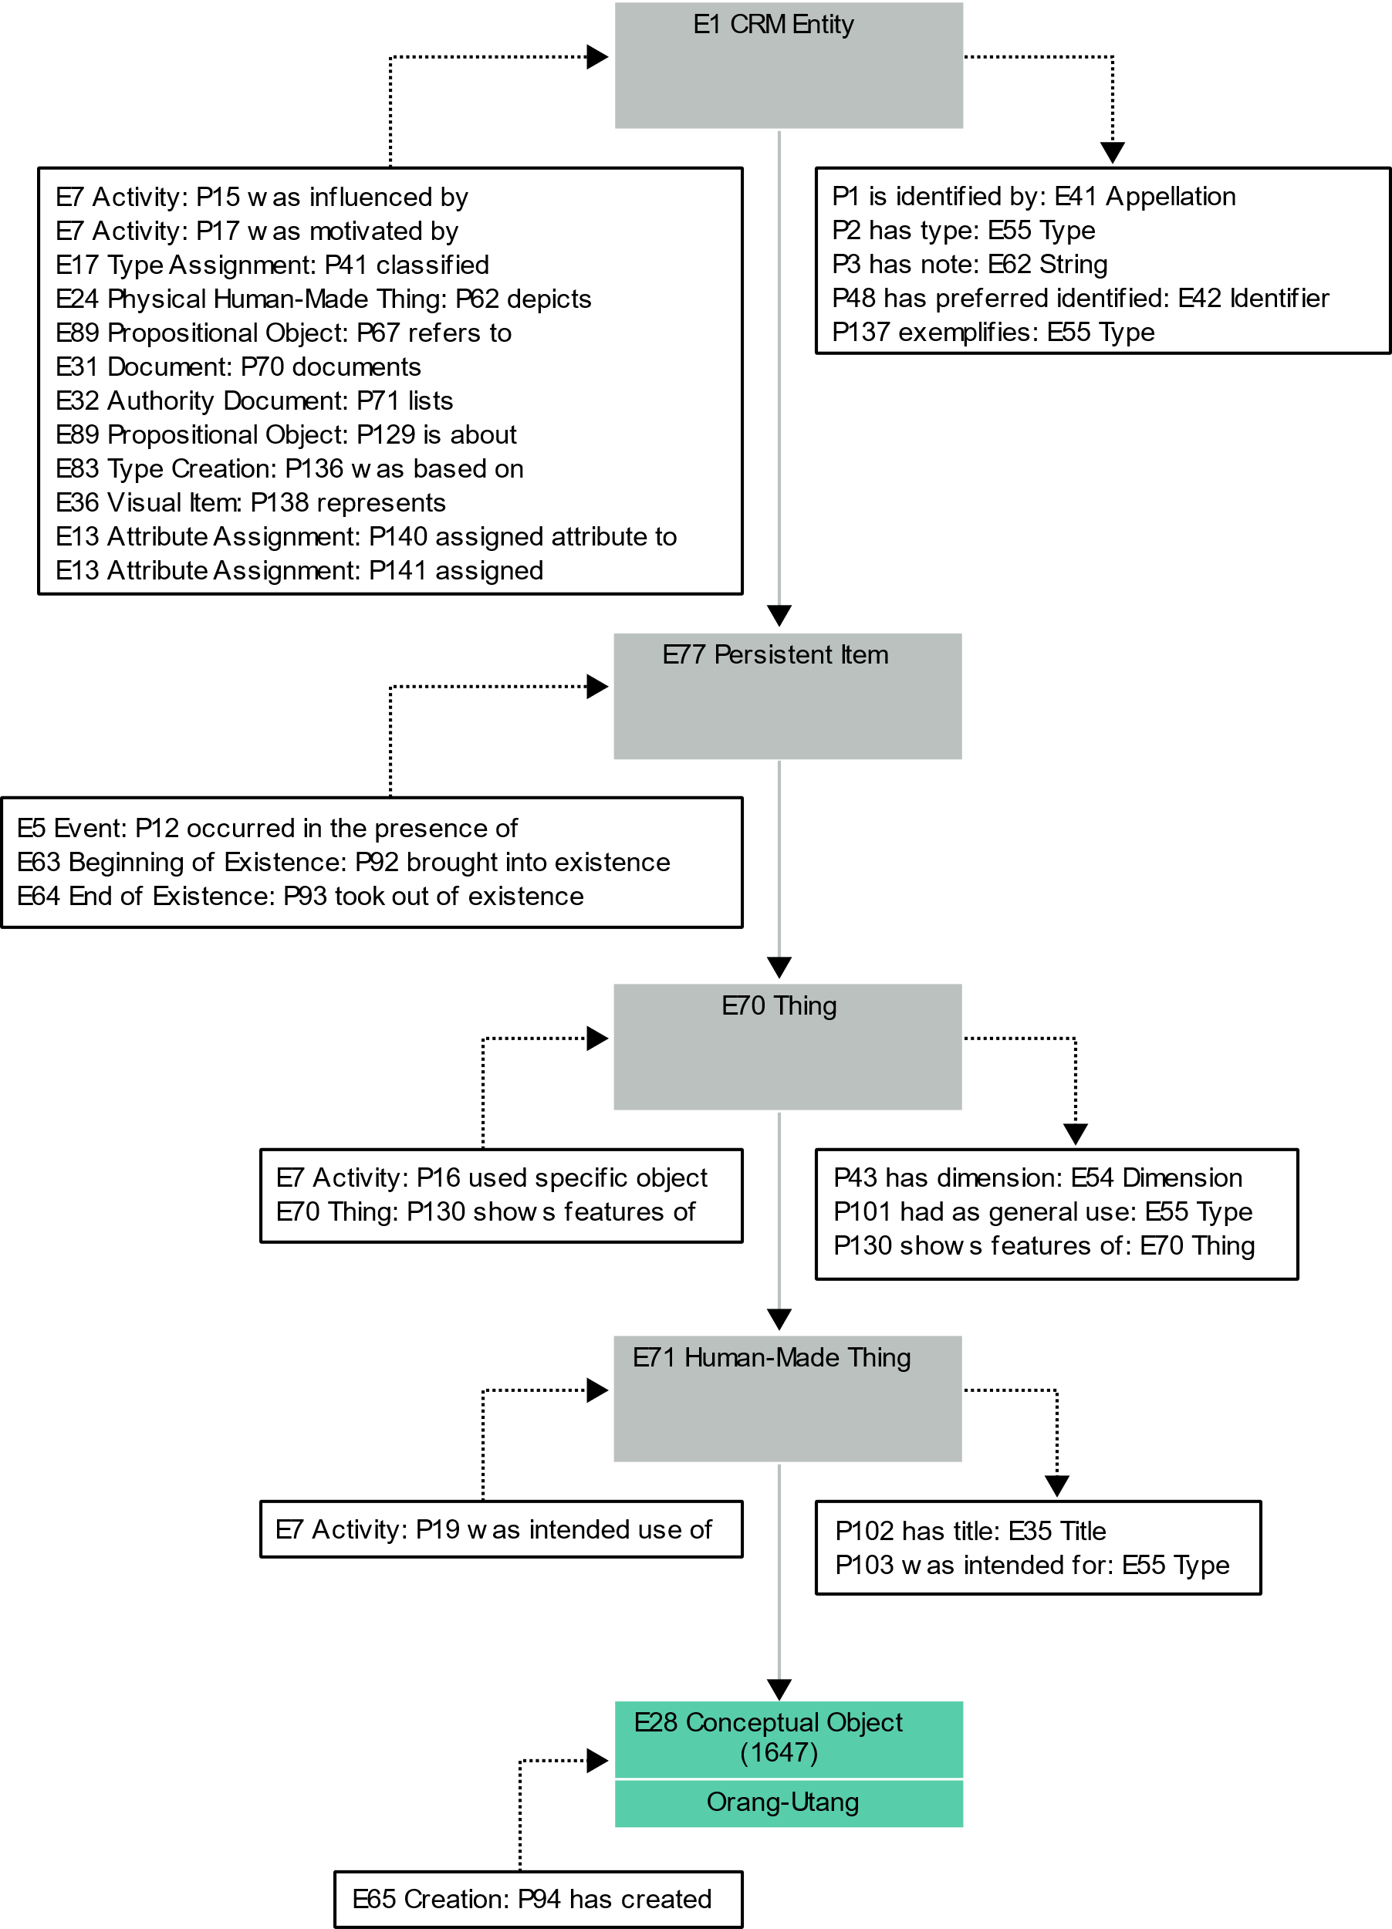
CIDOC CRM 7.1.1 Hierarchy I
Semantic classes are hierarchical → reflect information with different levels of detail
Modeling:
Annotated word(s) are assigned a semantic class → semantic entity
The context of a semantic entity can be modeled by adding a labeled link to another semantic entity → these labeled links are called properties
The possible set of properties between two semantic classes are strictly defined and are inherited through the hierarchy
Latest stable version 7.1.1 was released in May 2021 and includes 81 Classes & 160 Properties
Beispiel einer z.B. E8 aus dem
OrangUtan-Teil in der Hierarchie
Darstellen also mit Parents und
Vererbten Properties

Slide 24
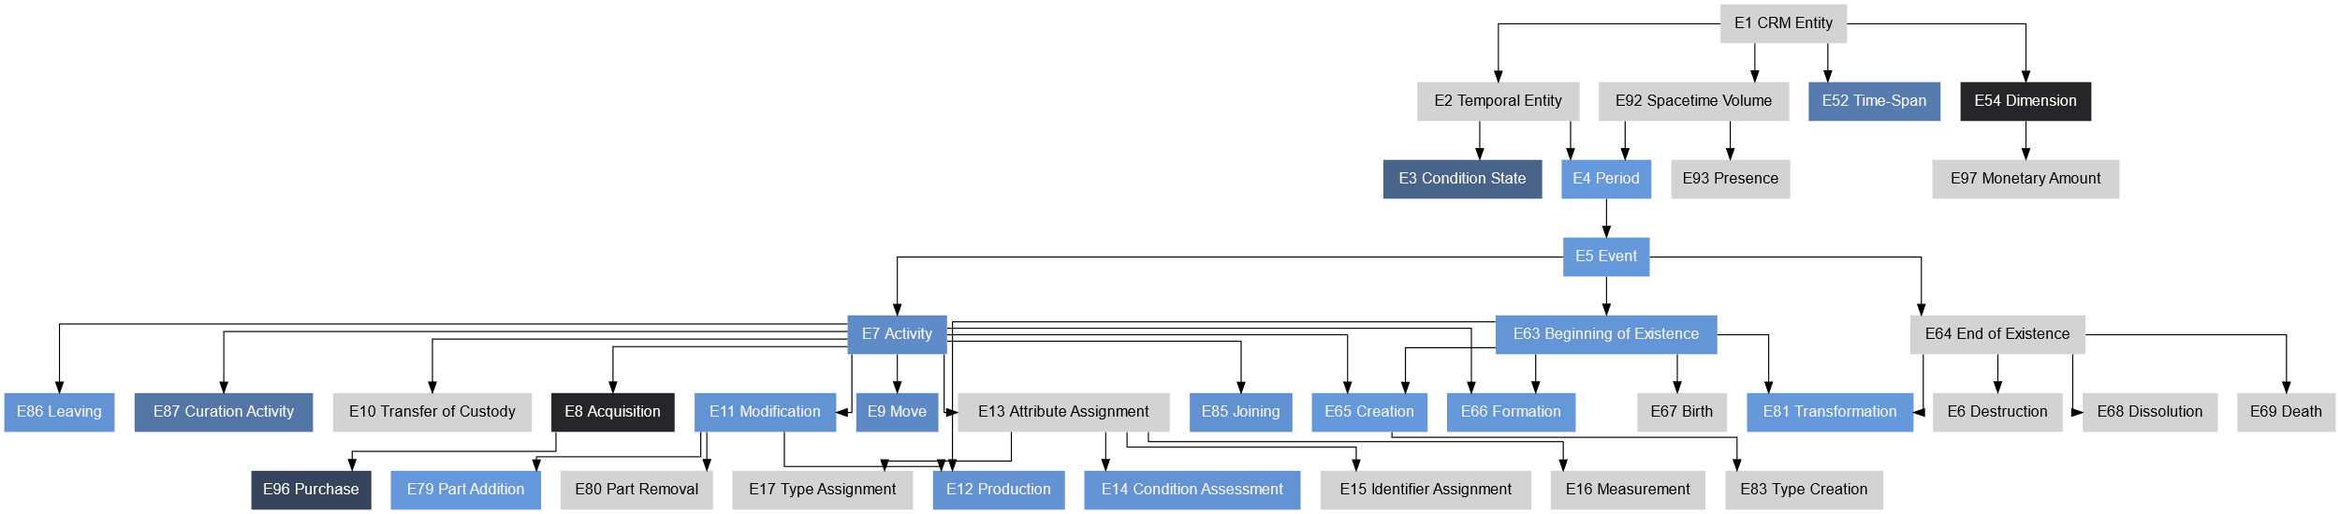
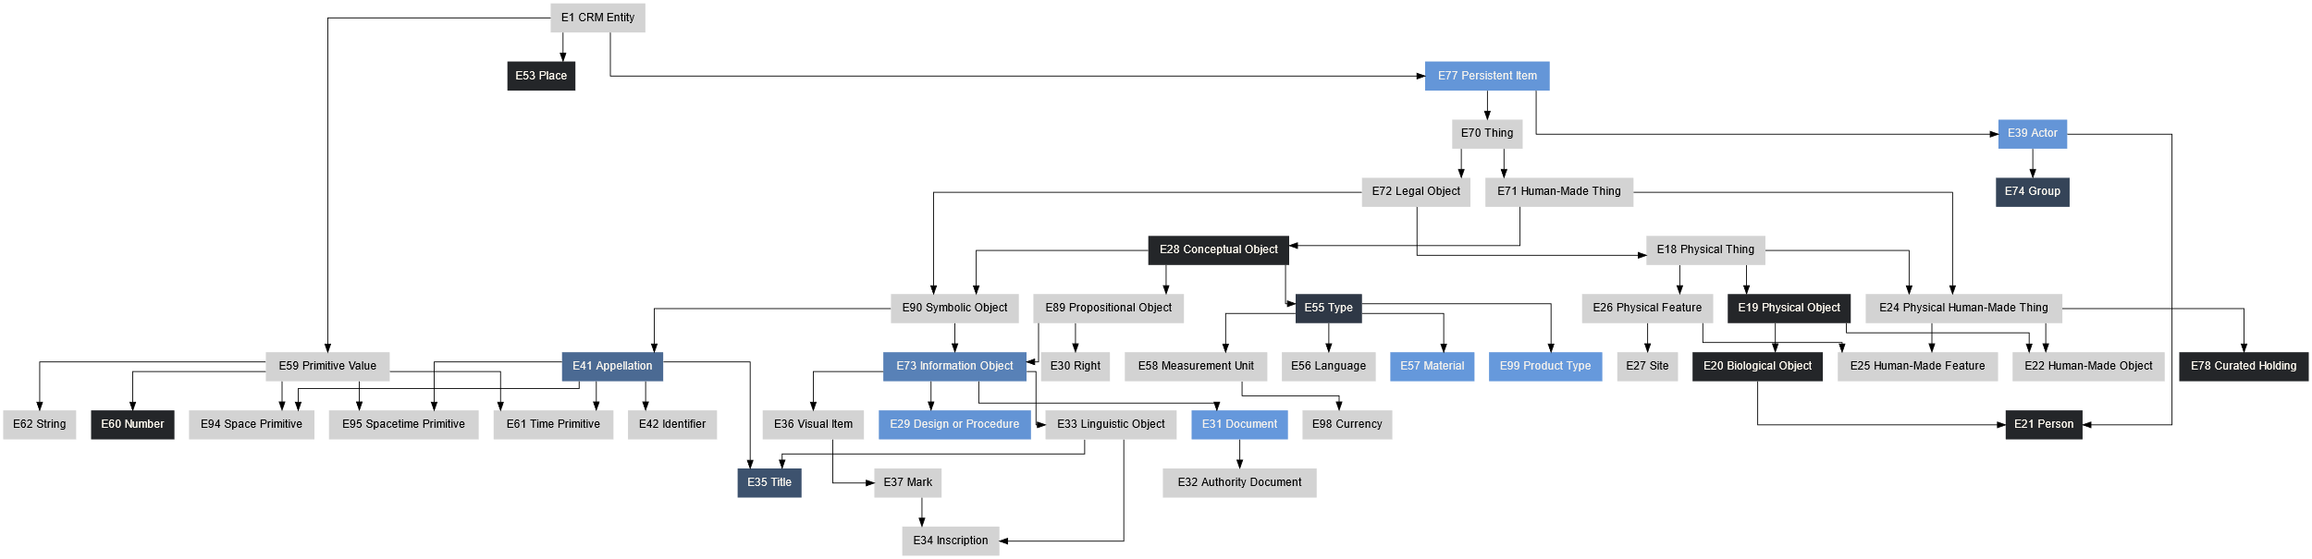
CIDOC CRM 7.1.1 Hierarchy II

Slide 25
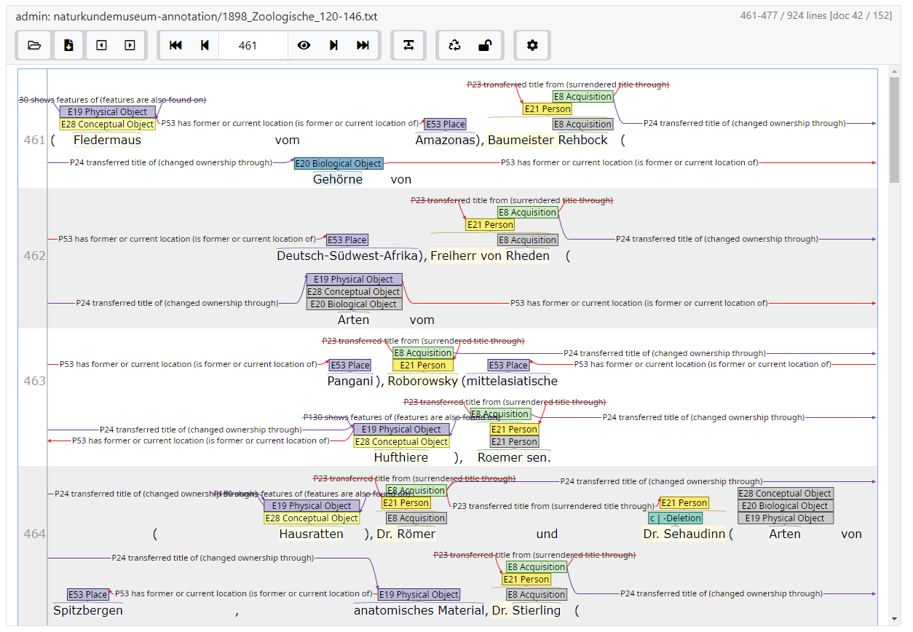
Virtual Entities
The very dense description in the reports has the consequence that:
Many terms are mentioned only implicitly through context but have no real explicit representation in the text
But we need those to correctly model the semantic structure using CIDOC CRM
Implementation of “virtual” entities which have no corresponding words in the text
This has the effect that there are paragraphs which consist of more entities than words
Manual annotating eats time!
(insert screenshot of INCEPTION densely annotated)

Slide 26
Status
Annotations:
11538 entities representing 39 semantic classes, connected by 12610 properties of 60 types
We greatly underestimated the effort required for manual annotating, so lately we have been focusing only on acquisitions of objects
Product:
Frontend: Prototype of Website
Backend: draft of model, in contact with Web Team
Semantic Class | Σ of entities
E21 Person | 2178
E53 Place | 1493
E8 Acquisition | 1020
E19 Physical Object | 1012
E20 Biological Object | 536
E78 Curated Holding | 503
E28 Conceptual Object | 452
E54 Dimension | 383
E55 Type | 214
E74 Group | 189
… | …
Semantic Property | Σ of entities
P23 transferred title from | 2424
P2 has type | 2363
P53 has location | 2095
P24 transferred title of | 1260
P23 transferred title to | 1158
P43 has dimension | 670
P130 shows features of | 639
P46 is composed of | 609
P4 has time-span | 365
P94 has created | 176
… | …

Slide 27
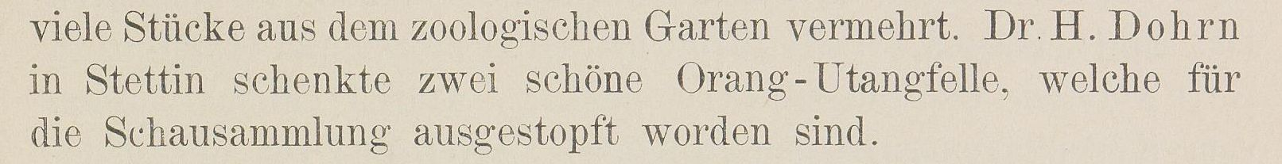
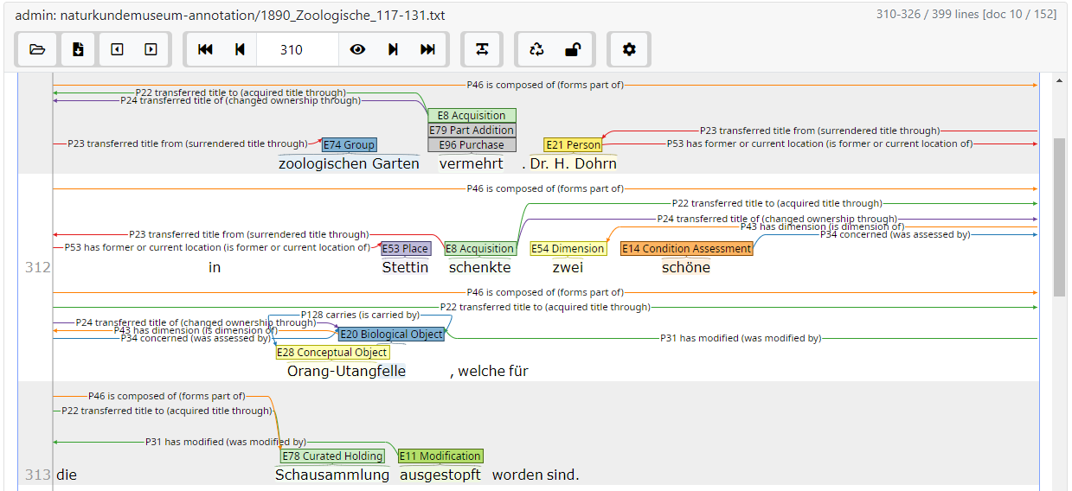
Datenmodellierung mit CIDOC CRM
P1 is identified by
E42 Identifier
P71 is listed in
E32 Authority Document
Q393
P71 is listed in
Wikidata
P53 has former or current location
P1 is identified by
E42 Identifier
P71 is listed in
E53 Place
E21 Person
Q1597054
Stettin
Dr. H. Dohrn
E42 Identifier
Q41050
E52 Time-Span
E55 Type
P23 transferred title from
E78 Curated Holding
1890
Donation
Zoologische Sammlung
P1 is identified by
P2 has type
P2 has type
E8 Acquisition
P46 forms part of
E55 Type
P4 has time-span
schenkt
E78 Curated Holding
Genus
E55 Type
P24 transferred title of
P22 transferred title to
Schausammlung
Accession Date
P46 forms part of
P2 has type
E60 Number
E20 Biological Object
E11 Modification
E28 Conceptual Object
zwei
Fell
ausgestopft
Orang-Utan
P57 has number of parts
P31 has modified

Slide 28
Product
Semantically annotated texts of the annual reports of the Museum
RDF/XML-Files
TEI/XML-Files
Website for interactive exploration through
Querying of Annotations
Visualization of annotations in their textual context
Visualization of annotations in their semantic context
Presentation of (exemplary) analyses
(Simple web system for delivering the data)

Slide 29
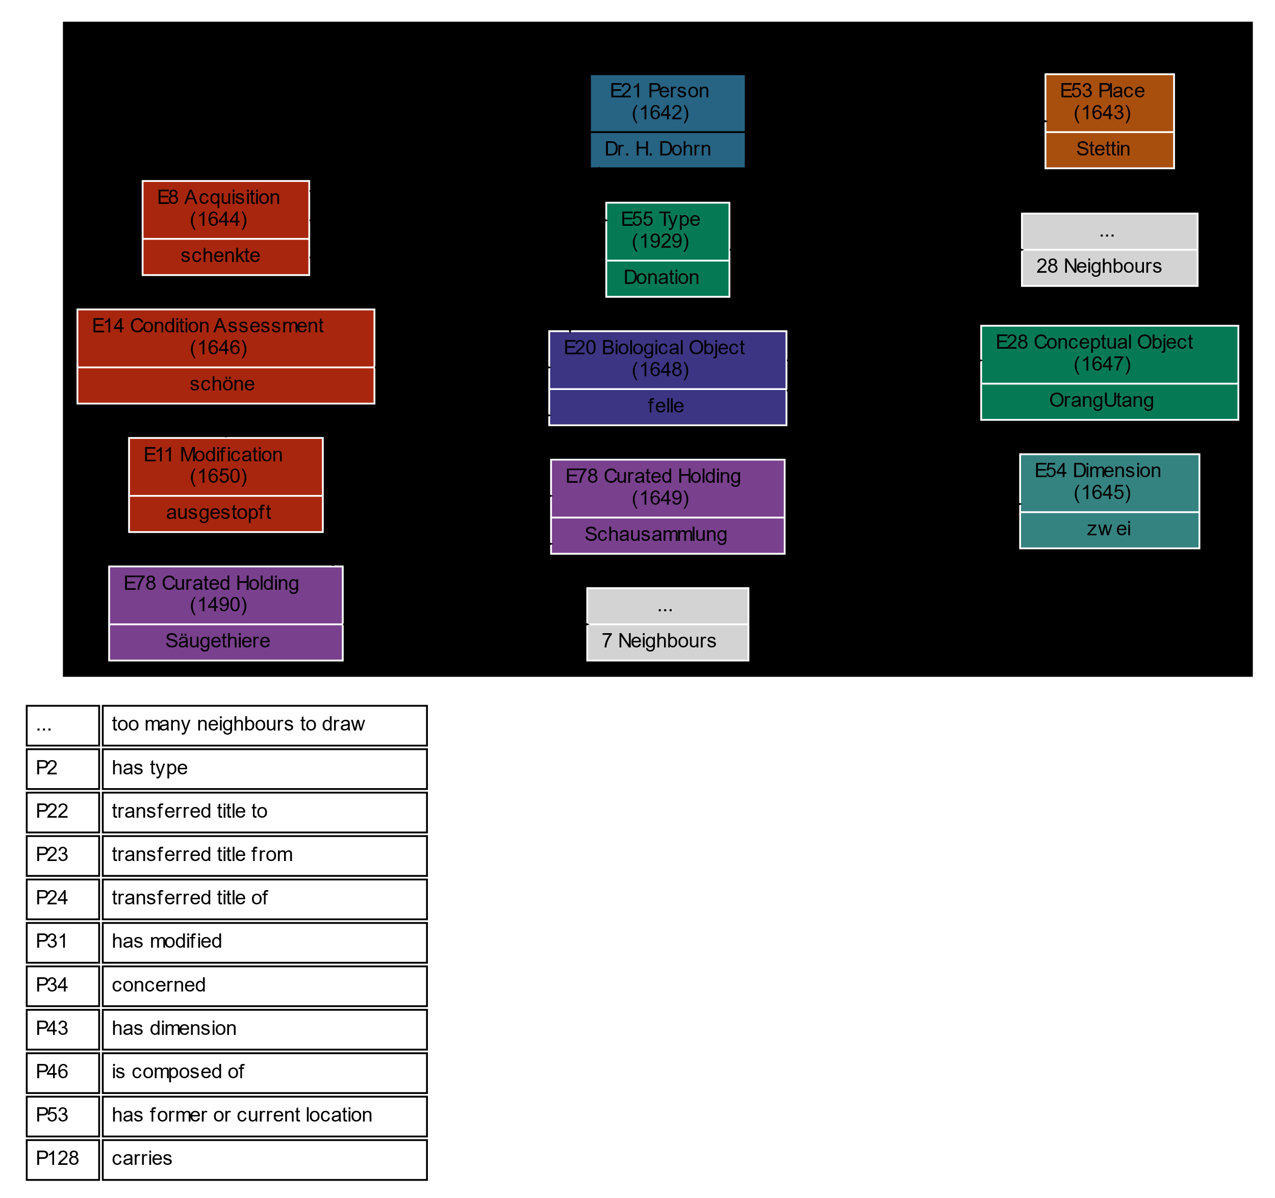
On demand rendering of semantic subgraphs

Slide 30
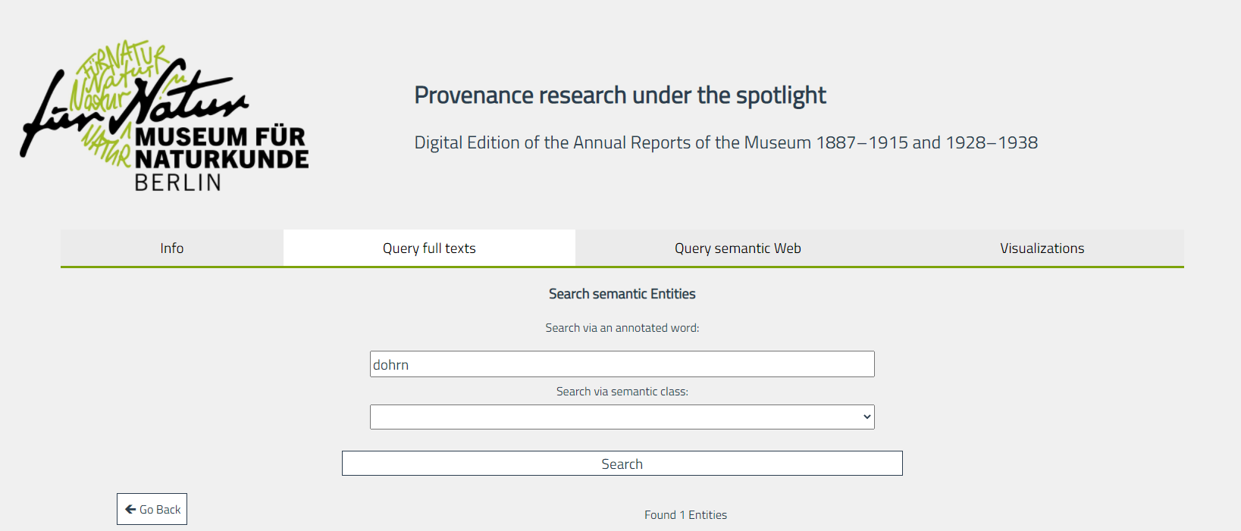
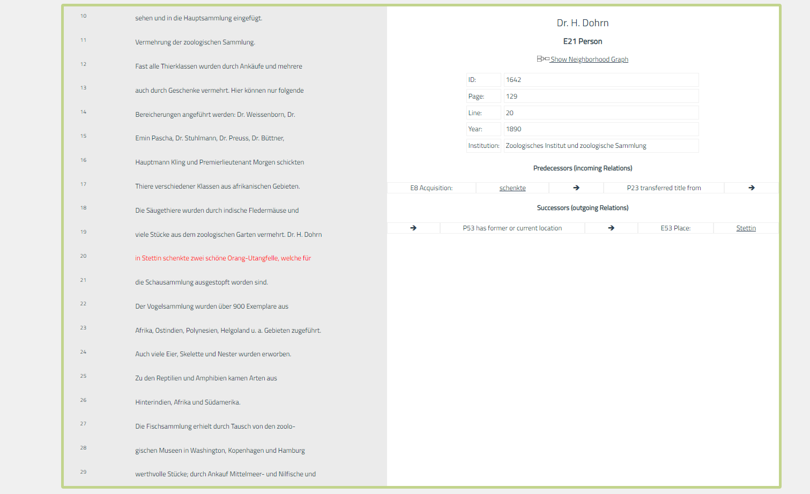
Prototype of Website

Slide 31
Integrate
Annotations-Prozess:
Tool: INCEpTION
Gute visuelle Darstellung
Möglichkeit zur Kollaboration (kann als Server-System verwendet werden)
Vorschläge für Annotationen basierend auf den bisherigen Annotationen
Drei Annotations-Layer:
OCR-Korrekturen
Semantische Entitäten
Semantische Eigenschaften, klassifizierte Verbindungen zwischen Entitäten
Validierung & Konsolidierung
Parsen der UIMA XML-Dateien (natives Speicher-Format von INCEpTION) zu:
Repräsentation in Python-Objekten → Pickle
GraphML
JSON für einen Prototypen der Website
(RDF Triplestore)
Dabei:
Anwendung der manuellen OCR-Korrekturen
Konsolidierung der Daten, Zusammenführen von Personen, Orten, Taxonomien etc.
Modellieren von virtuellen Entitäten und Eigenschaften
Skript mit dem das semantische Netz, in dem sich ein gesuchter Begriff befindet, visuell dargestellt wird (mittels Python und Graphviz/DOT)
Grundkonzept für das Websystem entworfen
Backend: Graphdatenbank (Berkeley DB) mit SPARQL Endpoint und REST API
Frontend: Möglichkeit zur visuellen Konstruktion von SPARQL-Queries, Vue.js

